Slide 1
Chapter 1.

Slide 2
What is the machine learning

Slide 3
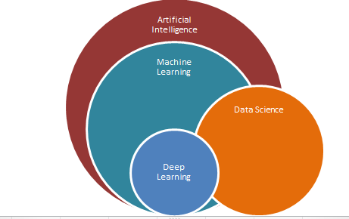
What is the machine learning
Machine learning
주어진 데이터를 이해하는 알고리즘
데이터에서 추출한 정보를 이용하여 예측 모델의 성능을 높임
Antonym: Rule based method

Slide 4
Type of machine learning
Supervised learning (지도 학습)
Unsupervised learning (비지도 학습)
Reinforcement leaning (강화 학습)

Slide 5
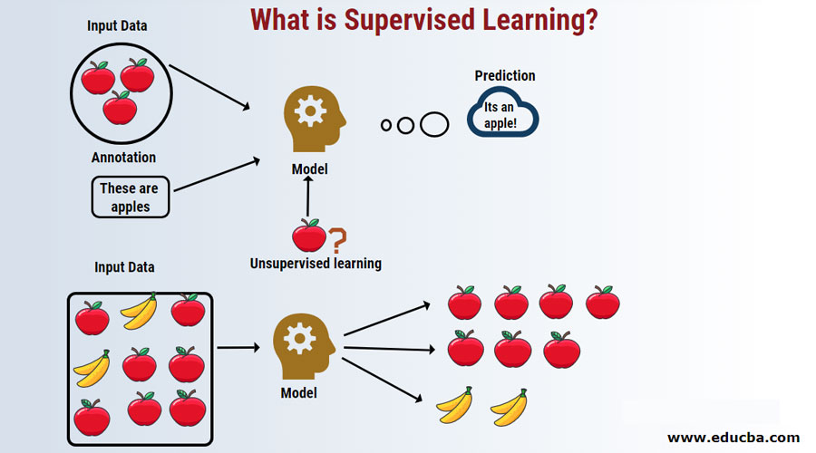
Supervised learning
Apple
Model
banana
Training set
Training step
weight
Model
“Apple”
Prediction step
Task: classification, regression

Slide 6
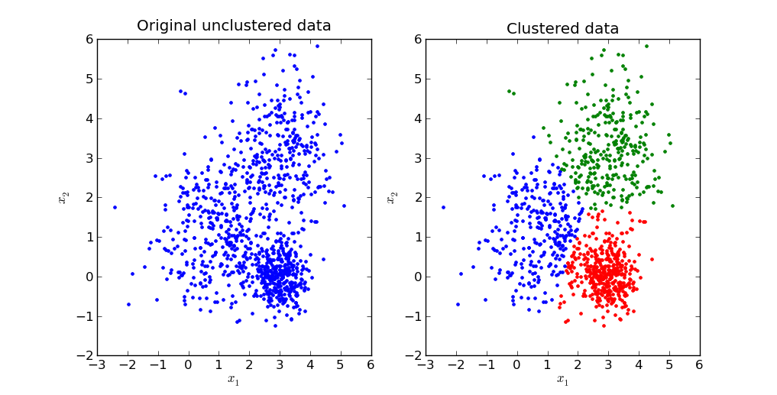
Unsupervised learning
Input data
Prediction result
Task: Clustering, dimension reduction

Slide 7
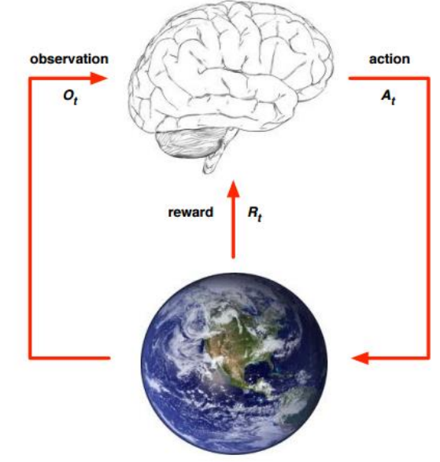
Reinforcement learning
Brain: Agent
Earth: Environment

Slide 8

Notation
Input
$$x^{(i)}=\left(\begin{matrix}{x^{(i)}}_{1}^{} \\ ⋮ \\ {x^{(i)}}_{n}^{}\end{matrix}\right)$$
Output
$$y^{(i)}=\left(\begin{matrix}{y^{(i)}}_{1}^{} \\ ⋮ \\ {y^{(i)}}_{n}^{}\end{matrix}\right)$$

Slide 9
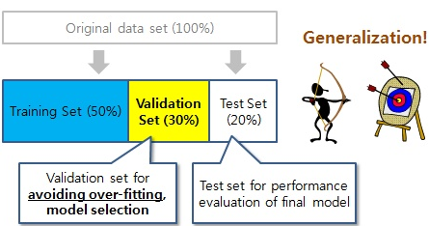
Machine learning system flow-chart
Pre-processing
training
evaluation
prediction
Pre-processing: dataset split
Evaluation: model performance evaluation (measure: accuracy, confusion matrix, and so on)

Slide 10
Machine learning application
Numpy
Based on C language
Support Vector calculation
scikit-learn
High-level machine learning library

